Slide 1






Web Scraper
UTSA CS 3443 - 003
Fall 2021
(Scravengers)
@Franklin-Johnson
@garashcake
@Nk3iru
@carlhertz
@ZenLoTek
Team Leader
Franklin Johnson
Maria Todorova
Nkeiru Nwogu
Carl Hertz
Aaron Sterzenback

Slide 2
Scravenger Web Scraper
Description
Our application will search a website input by the user for specific information defined by the user and output the results to a file or on screen.
Pitch
Scravenger Web Scraper is a data collection and extraction tool for use by businesses, professionals, or researchers to search web sites quickly and easily for specific information, extract that data and deliver it in a usable csv form. Web scraping is an efficient way to collect data and is used by businesses and individuals interested in product pricing data, market research, news monitoring and business lead generation, among other things. The internet is full of useful information and having the ability to access that data at the right time can help businesses make better informed and more profitable decisions.
UTSA CS 3443 - 003
Scravengers – Scravenger Web Scraper

Slide 3
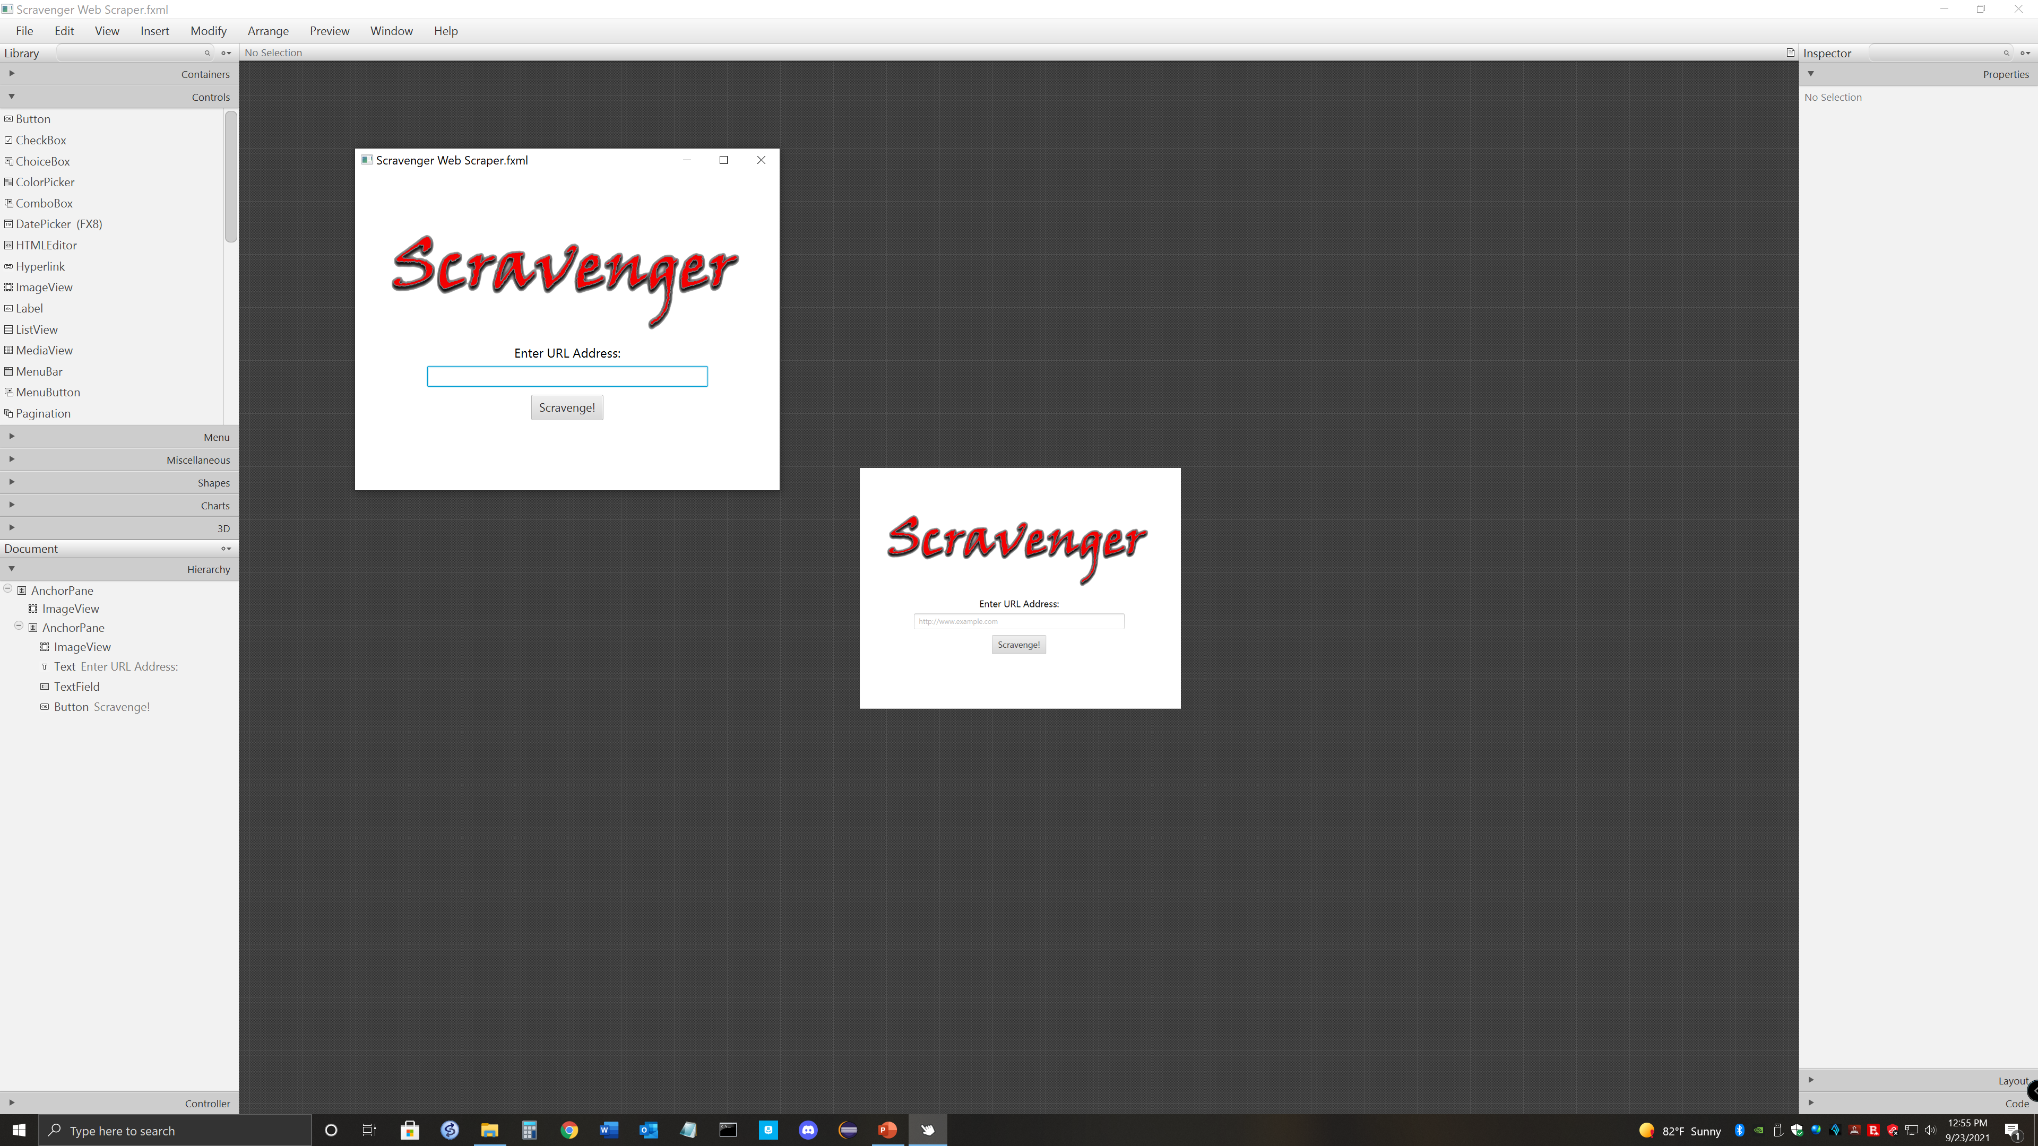
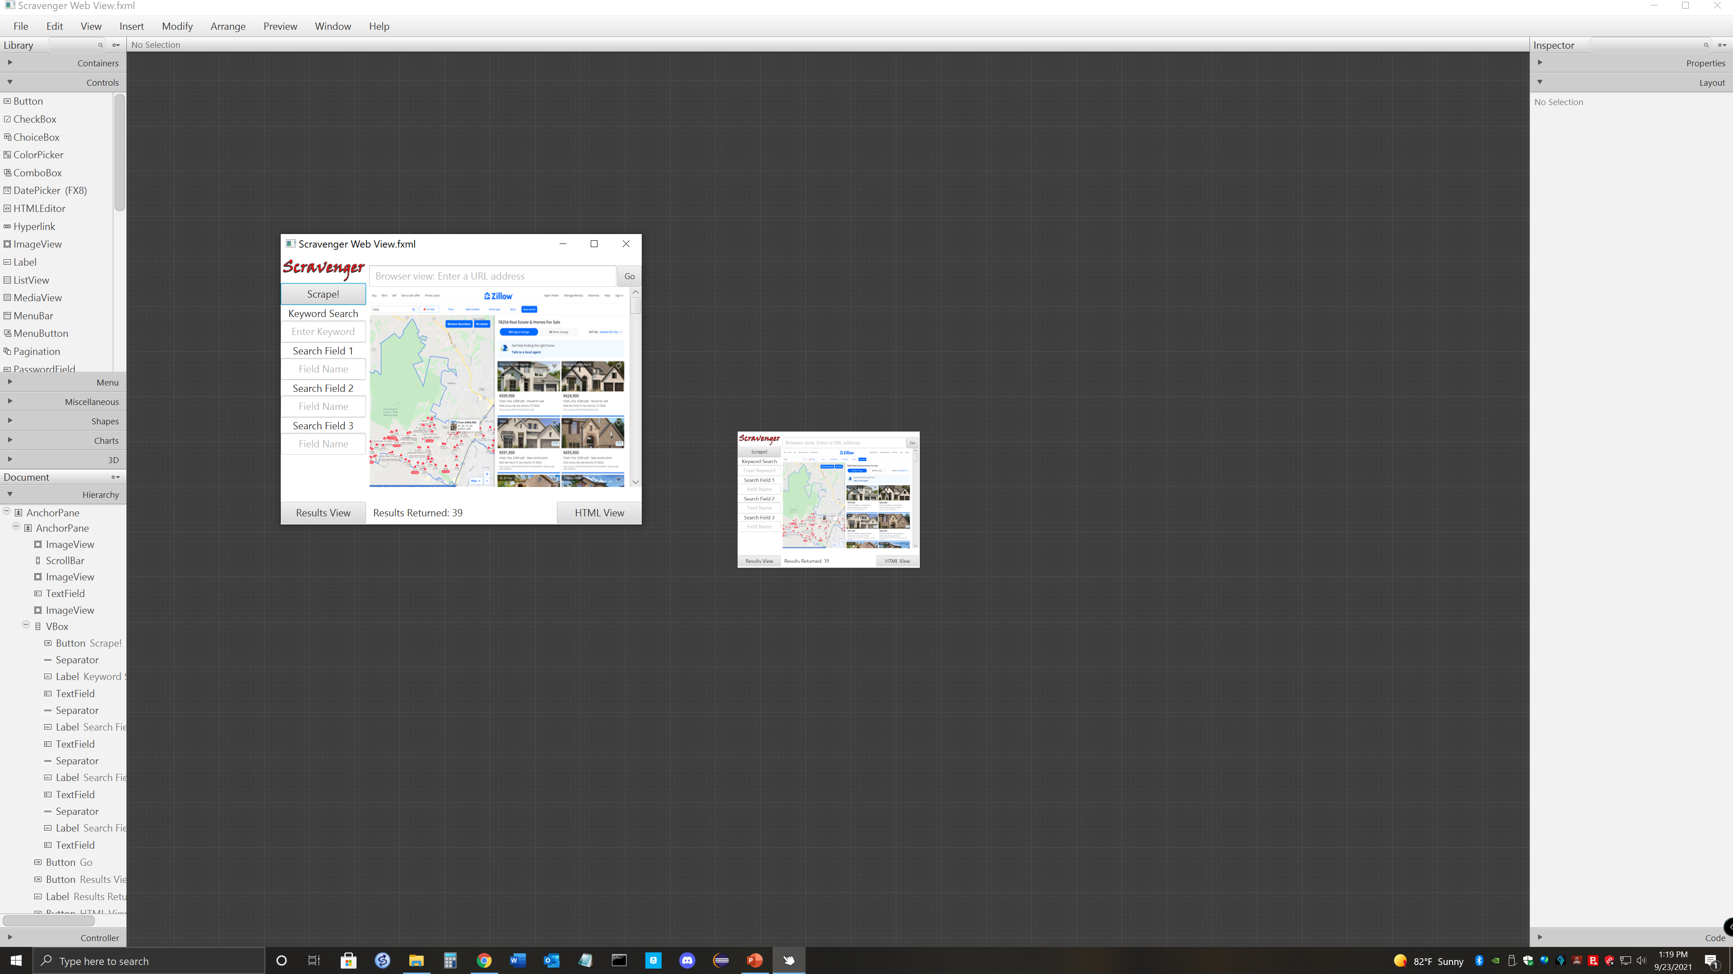
User Interface Design
UTSA CS 3443 - 003
Scravengers – Scravenger Web Scraper

Slide 4
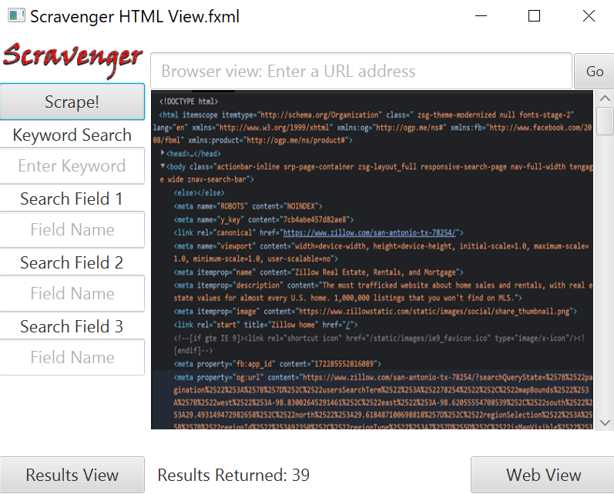
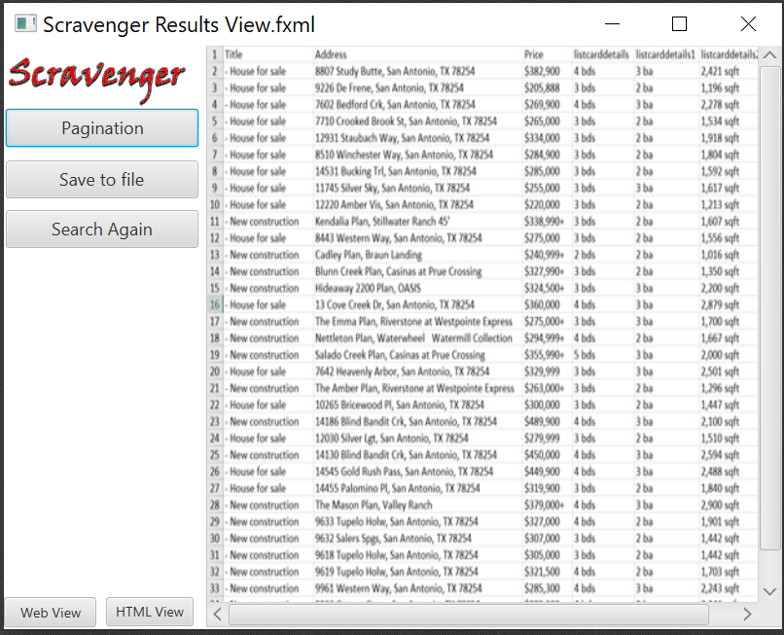
User Interface Design
UTSA CS 3443 - 003
Scravengers – Scravenger Web Scraper

